Slide 1




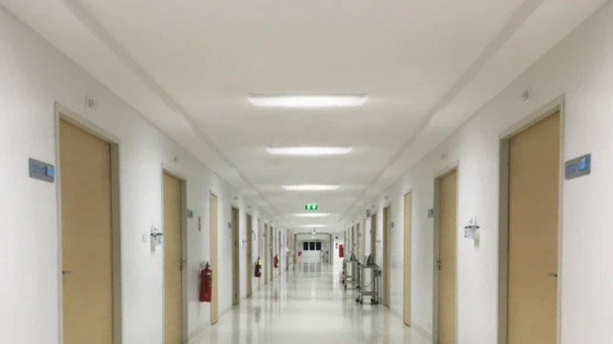
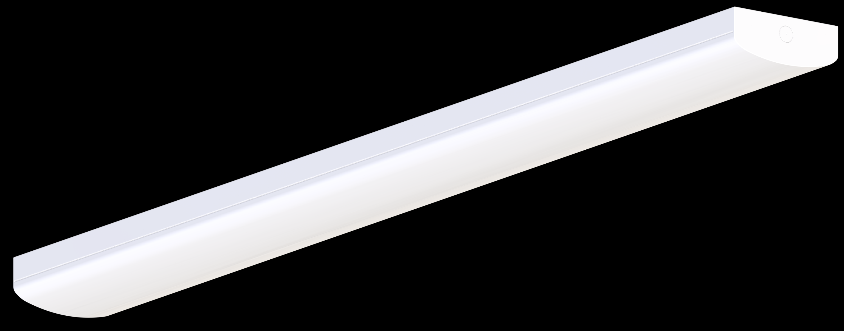

Linear Basic
Key Technical Specs
Features & Benefits
New Linear Basic luminaire with a clean, minimalist design
Available in three standard lengths: 0.6m, 1.2m, and 1.5m
Supports multi-power settings and dual CCT options (3000K / 4000K)
Motion detector (MD) version available for enhanced functionality
Lifetime to reach 50,000h at L80
DC compatible for integration with central emergency systems
Power (Multi) | 12/20, 22/40, 40/60W
Output | 1440/2400lm, 2640/4800lm, 4800/7200lm
CCT (Multi) | 3000K + 4000K
Motion Sensor | Yes
Length | 0.6m / 1.2m / 1.5m
Efficacy | 120 lm/W (4000K)
IP/IK | IP20 / IK06
CRI | >80
DC Compatible | Yes
Protection | Class I
Lifetime | 50.000h (L80)

