Slide 1
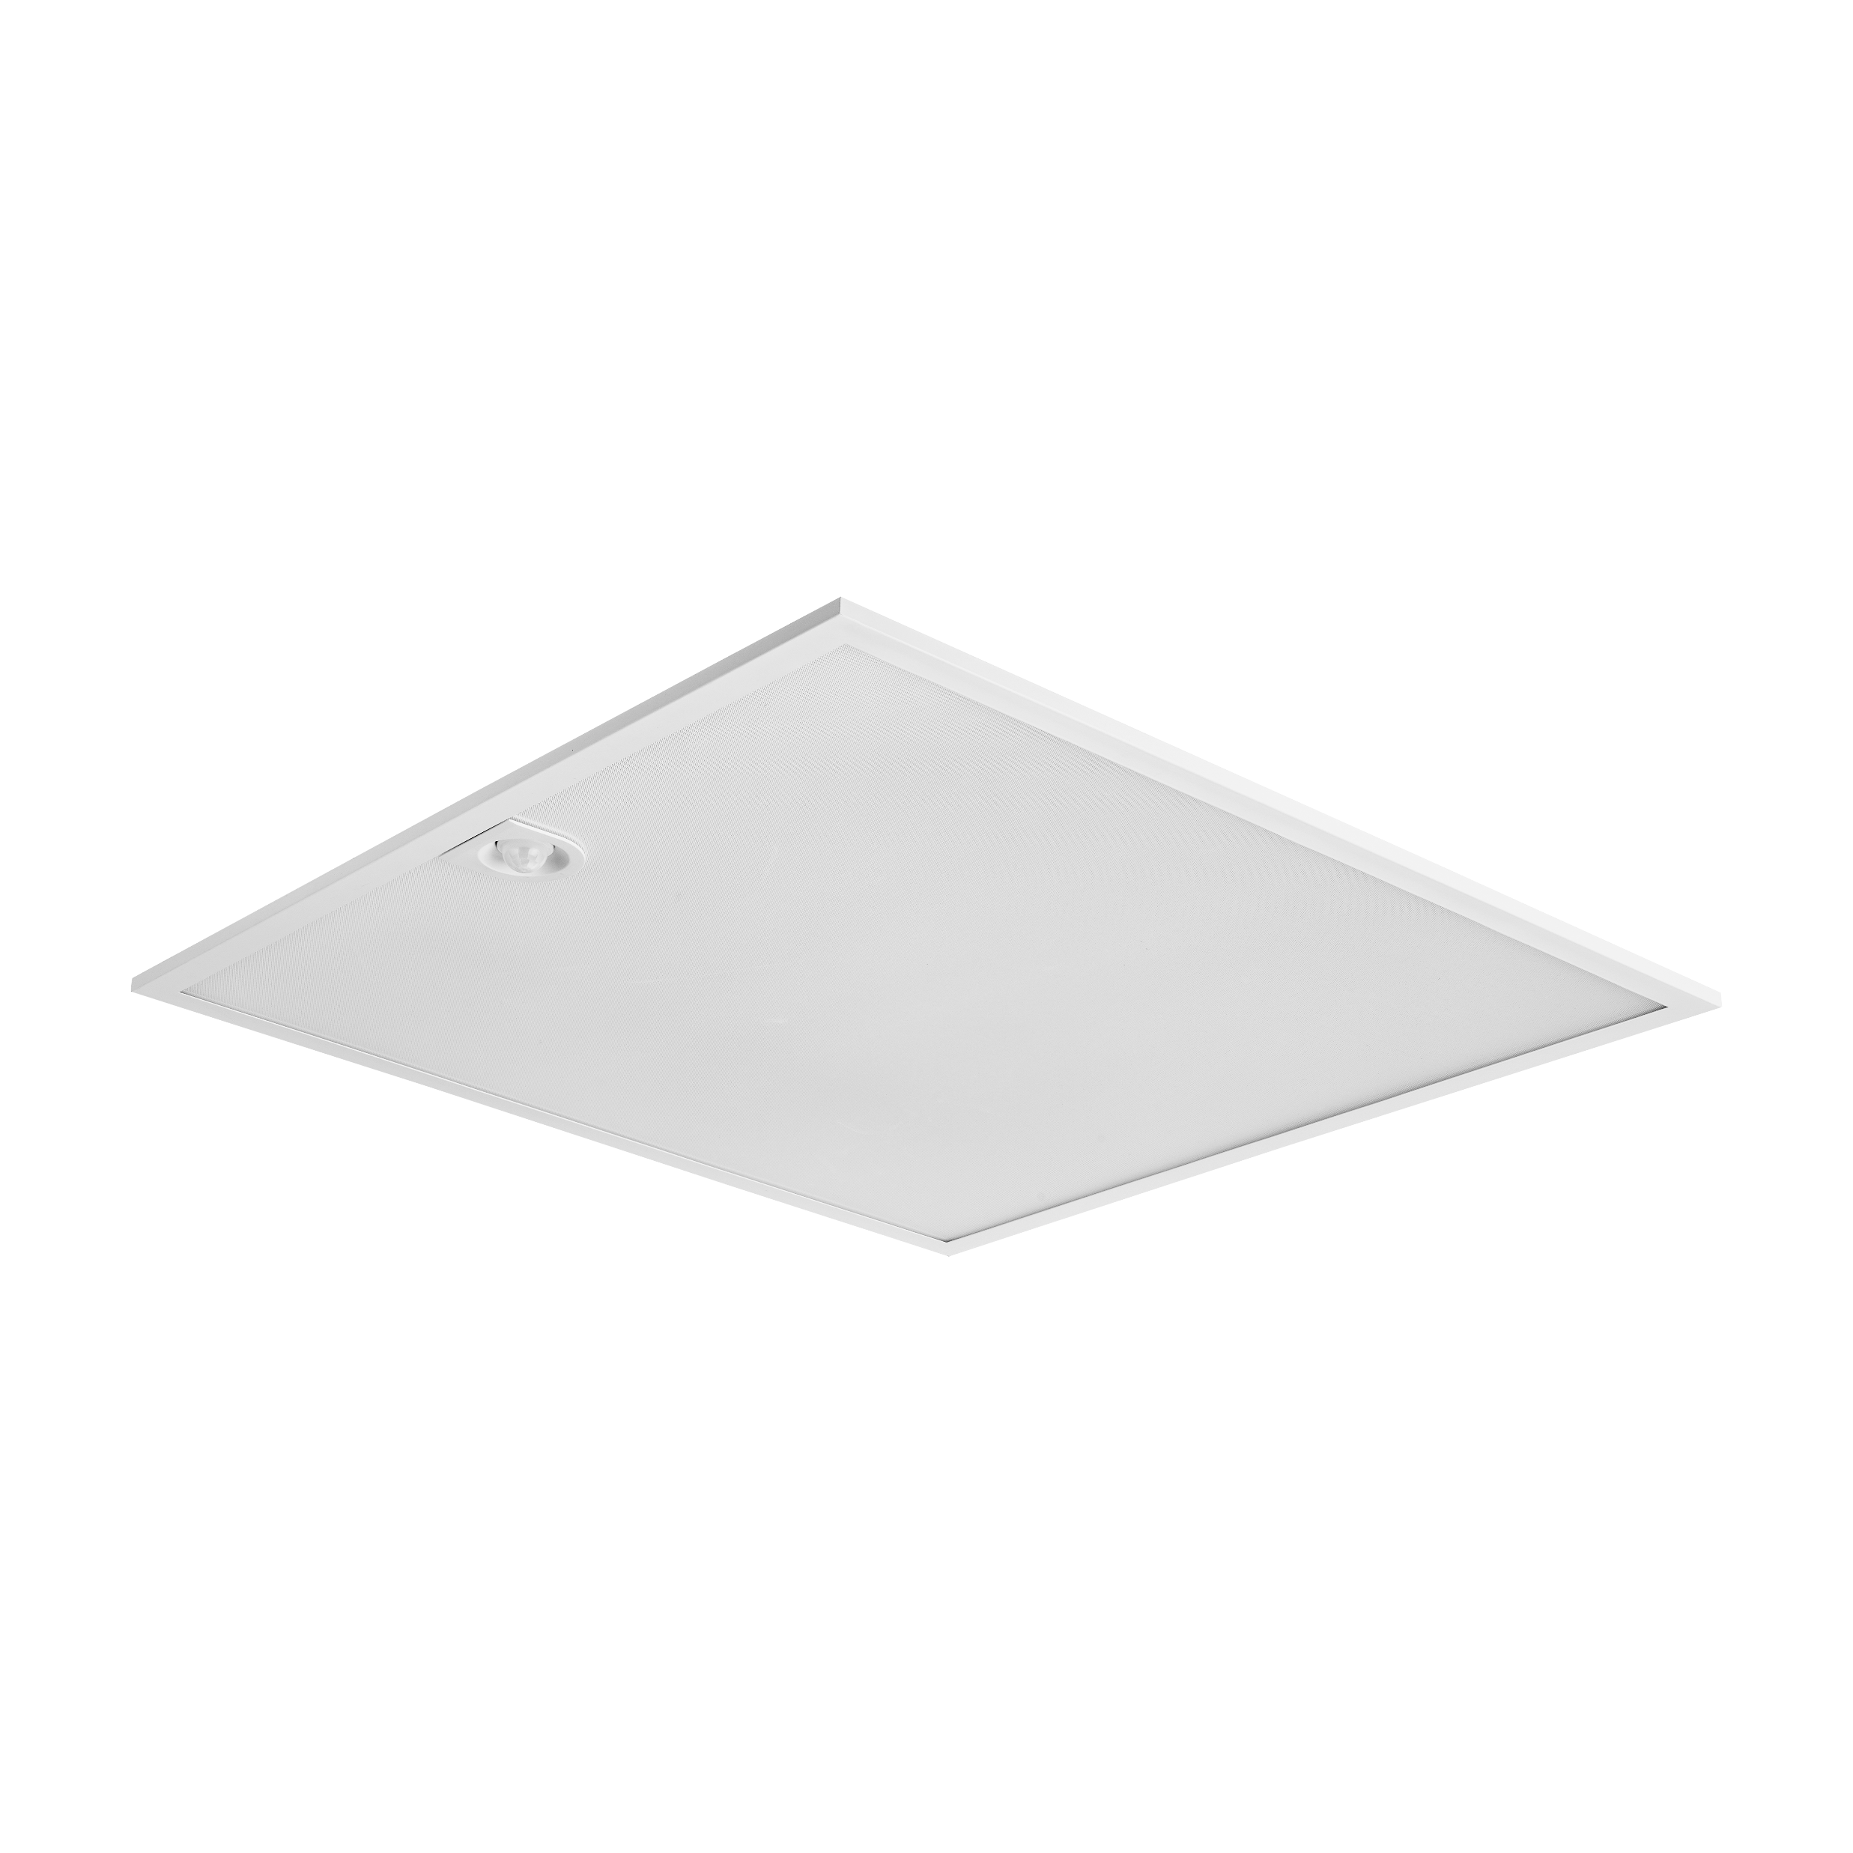

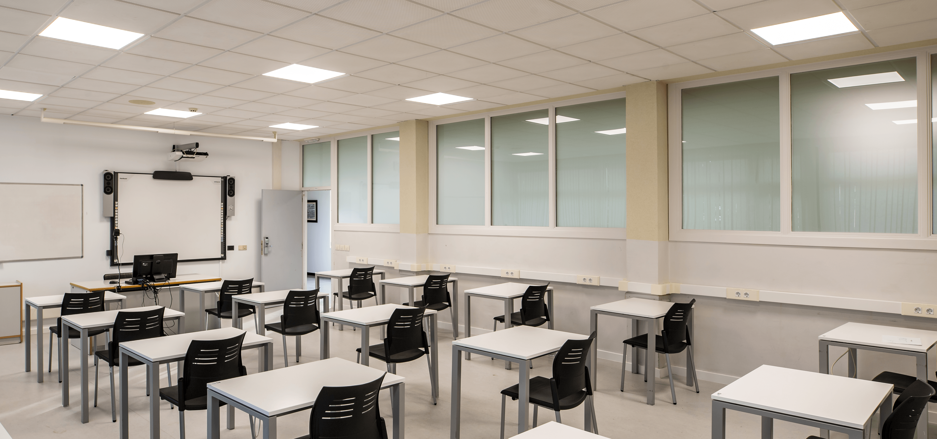


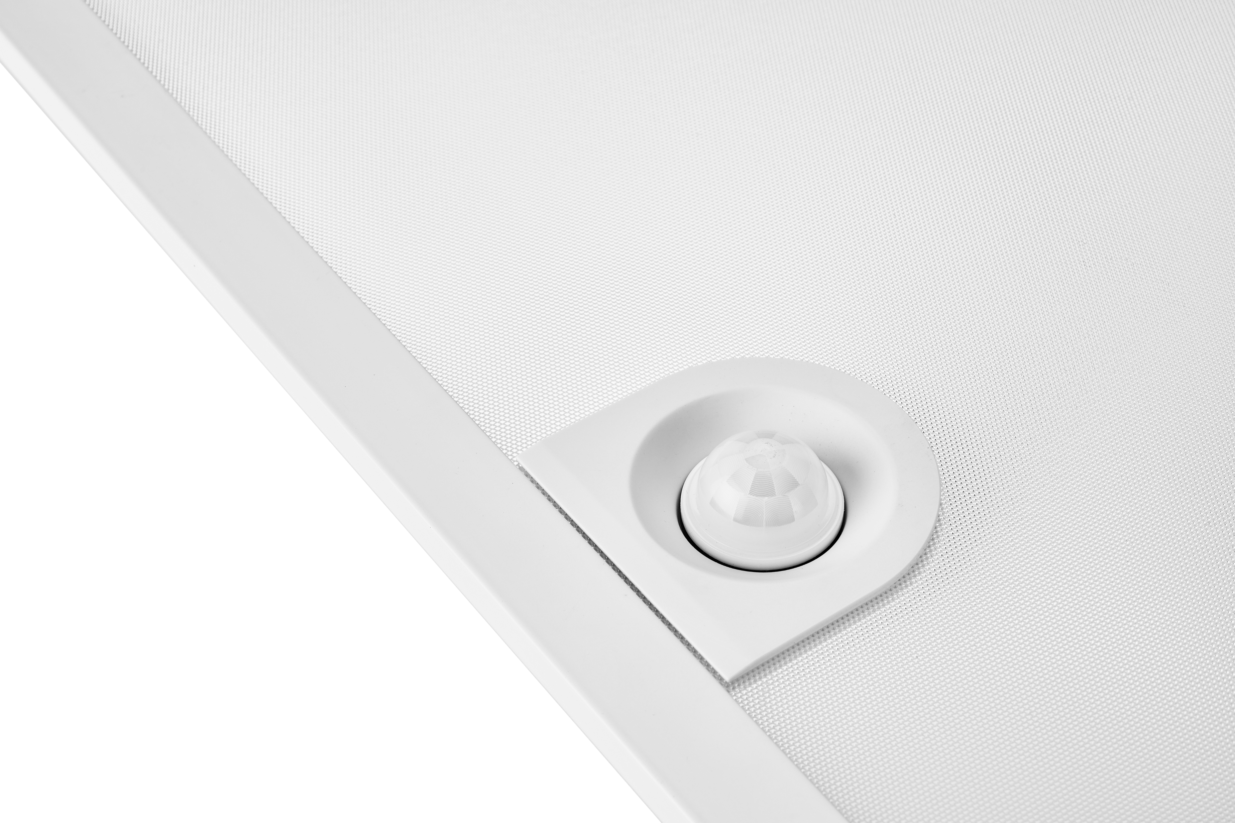
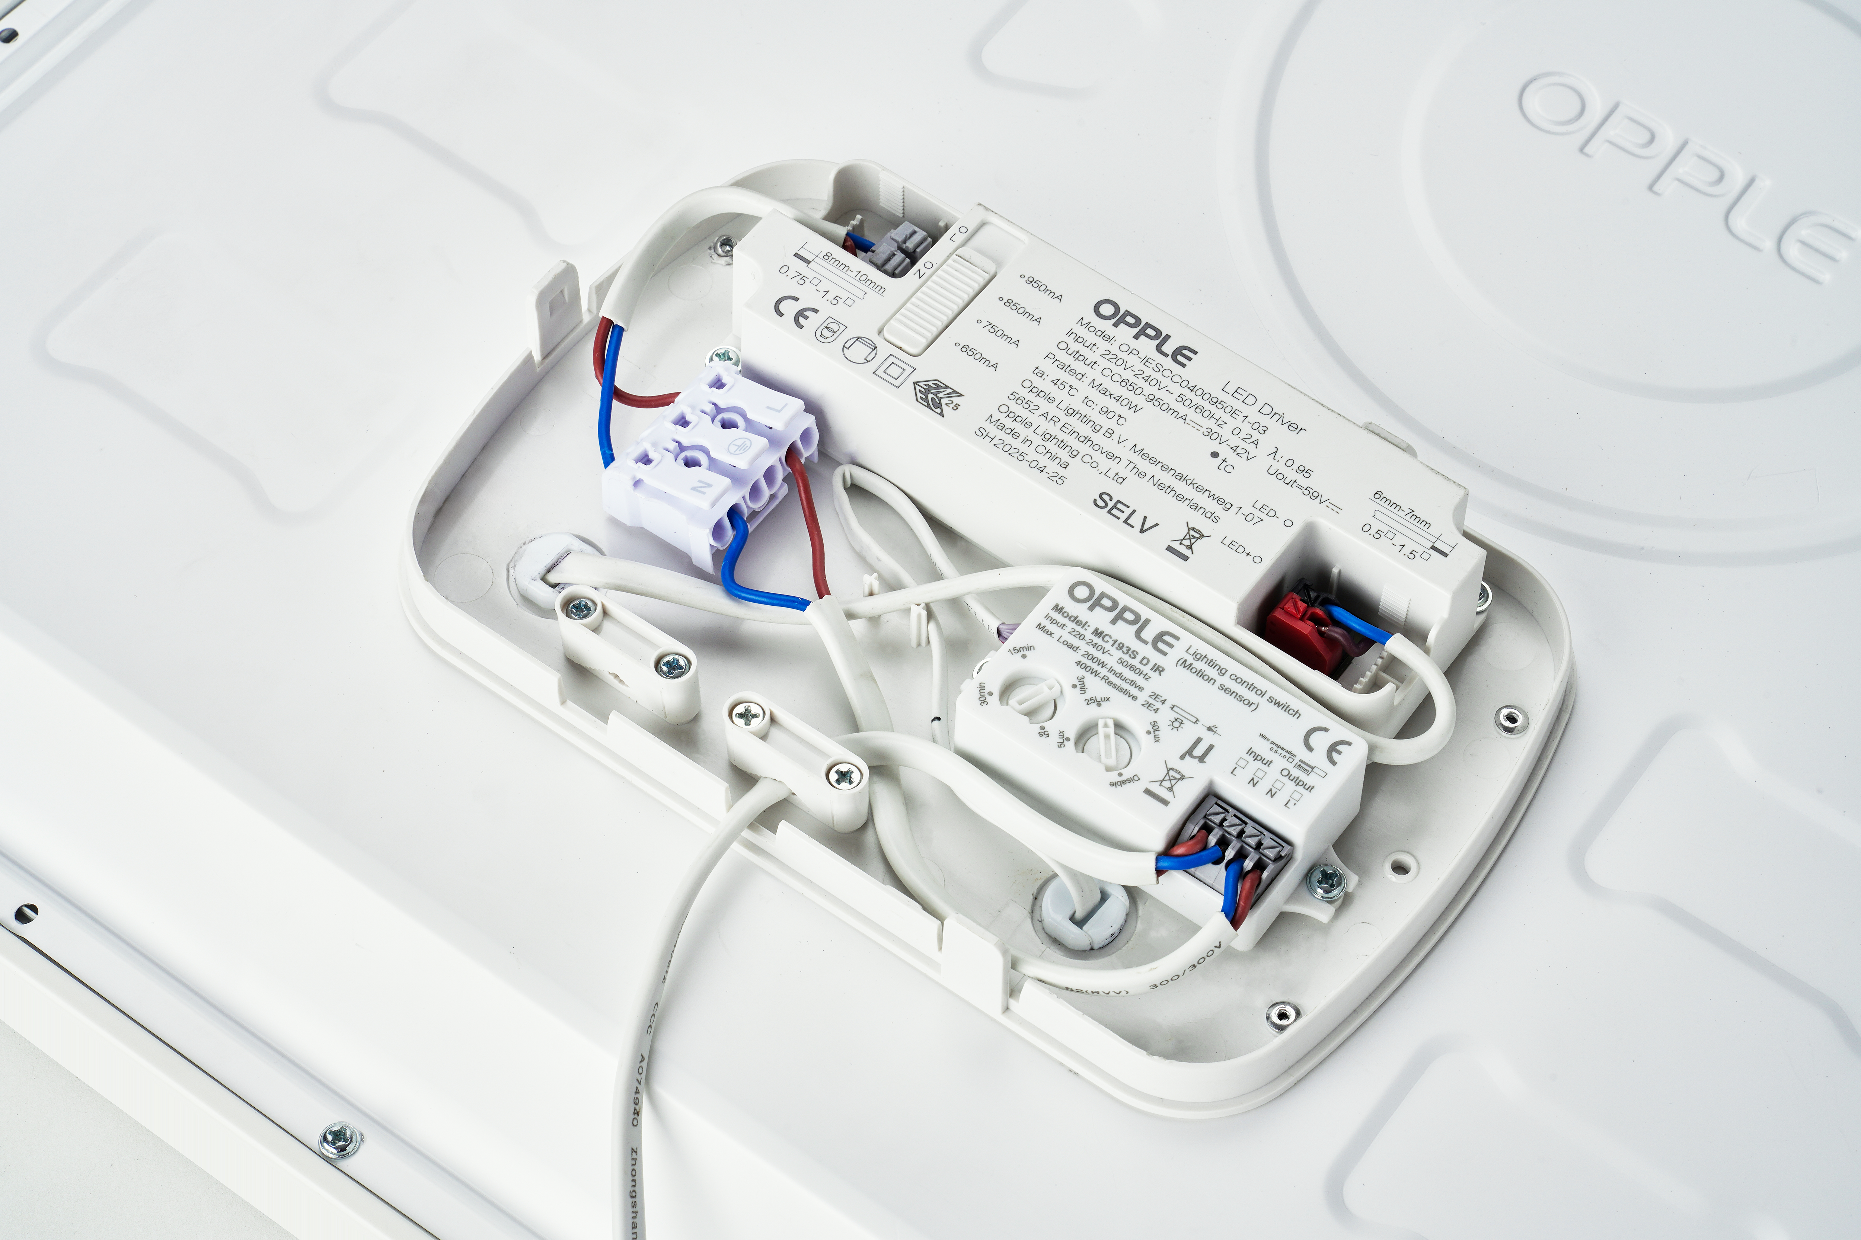

Slim panel Basic G4 PIR
Features & Benefits
Cost effective LED Slim Panels, suitable for offices
(UGR19)
Improved efficacy up to 130lm/W
Integrated PIR motion sensor with Master-Slave function
4 power levels possible (23/ 27/ 31/ 34 W)
Recessed ceiling frame and surface module kit available as accessory
Replacement for conventional 4x18W or 2x36W luminaire
Key Technical Specs
Power | 23/ 27/ 31/ 34
CCT | 3000/4000K
Output | 3840lm (4000K)
Dimensions | Sq595/Sq620
Control | ON/OFF + PIR sensor
Efficacy | 130lm/W (4000K)
UGR | ≤19
CRI | >80
Lifetime | 70.000h

