Slide 1


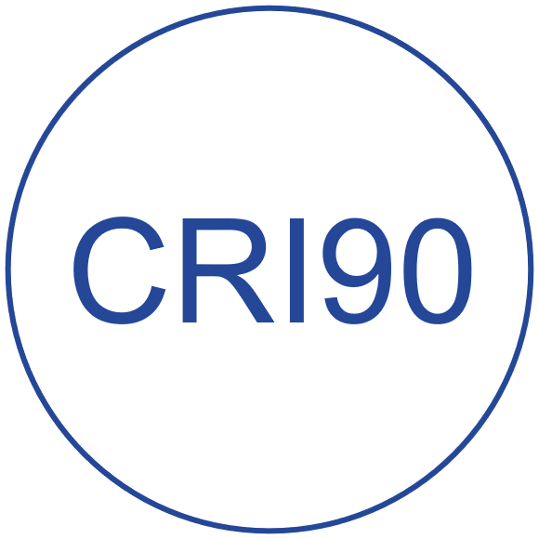


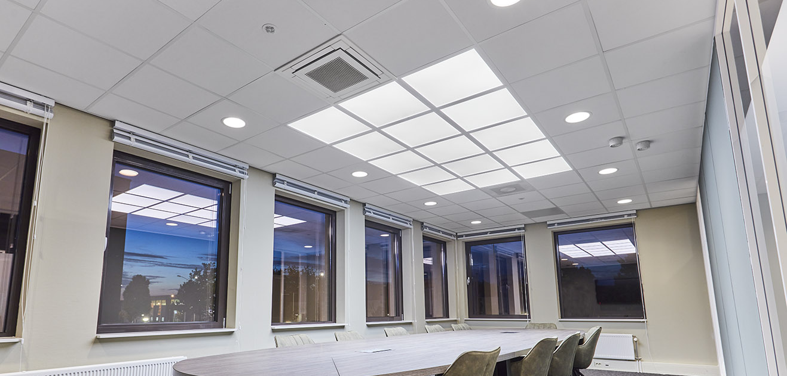
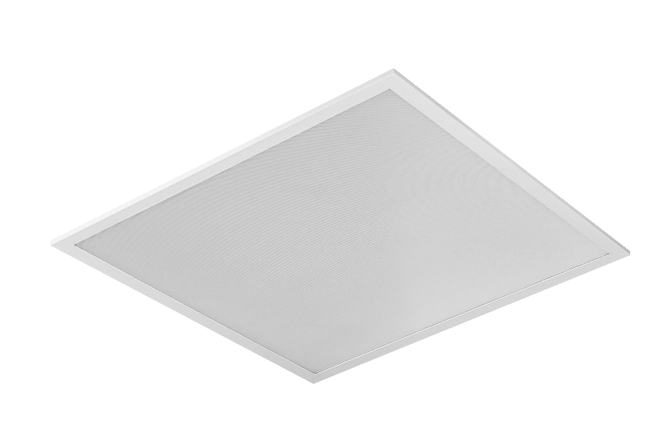
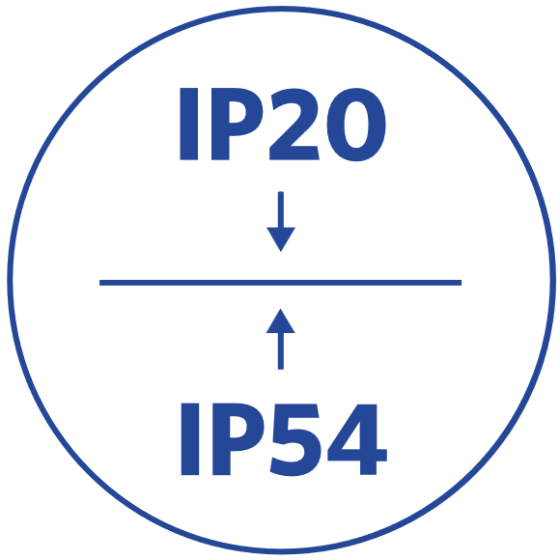


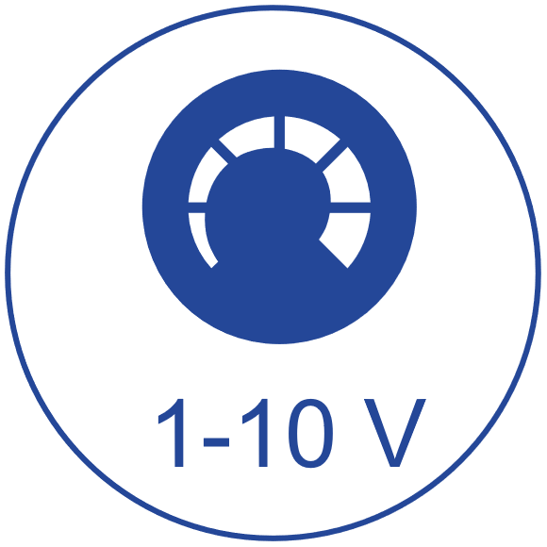

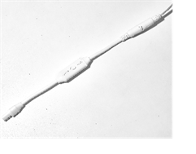

LED Slim panel performer G7
Key Technical Specs
Features & Benefits
High quality LED Slim Panel, suitable for offices (UGR19)
Improved efficacy up to 170lm/W, with output up to 4930lm
Tunable white Smart and DALI2 DT8 version available (2700-6500K)
Driver with integrated 4-step Power Switch
Versions with integrated CCT switch for color selection (3000K-4000K)
available
Standard IP54 (front side)
Recessed, suspended and surface mounting possible
DALI2 driver compatible with 230V push dimming
Power | 29W/26W/22W
CCT | 3000K/4000K/6500K/2700-6500K +3000/4000K (CCT-Switch)
Output | 4930/4420/3740 lm UGR <19 (+ 5610 lm >UGR19)
Efficacy | 170lm/W (4000K)
UGR | <19
CRI | 80/90 (4000K only)
IP | IP54 frontside
Dimming | Static/DALI2/1-10V/BLE2
Lifetime | 100.000h (L70B50)

