Slide 1




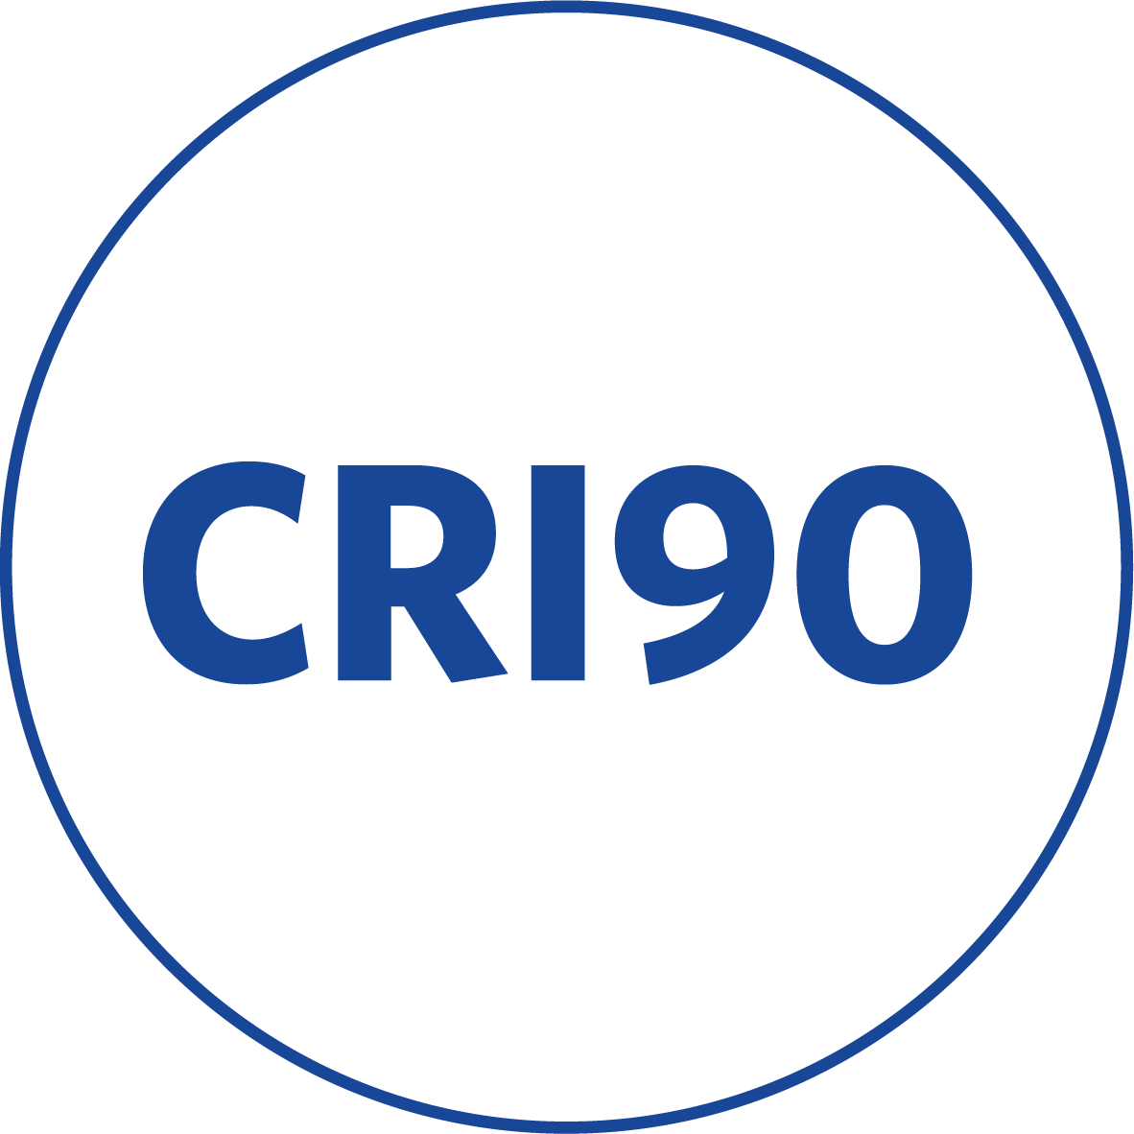
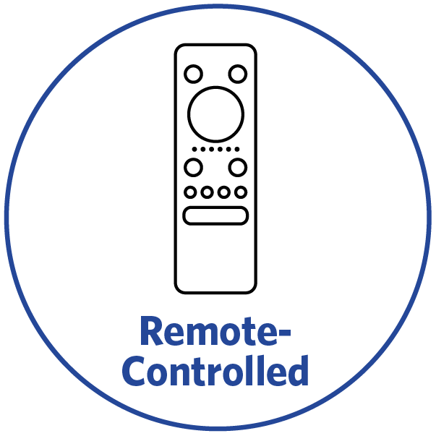

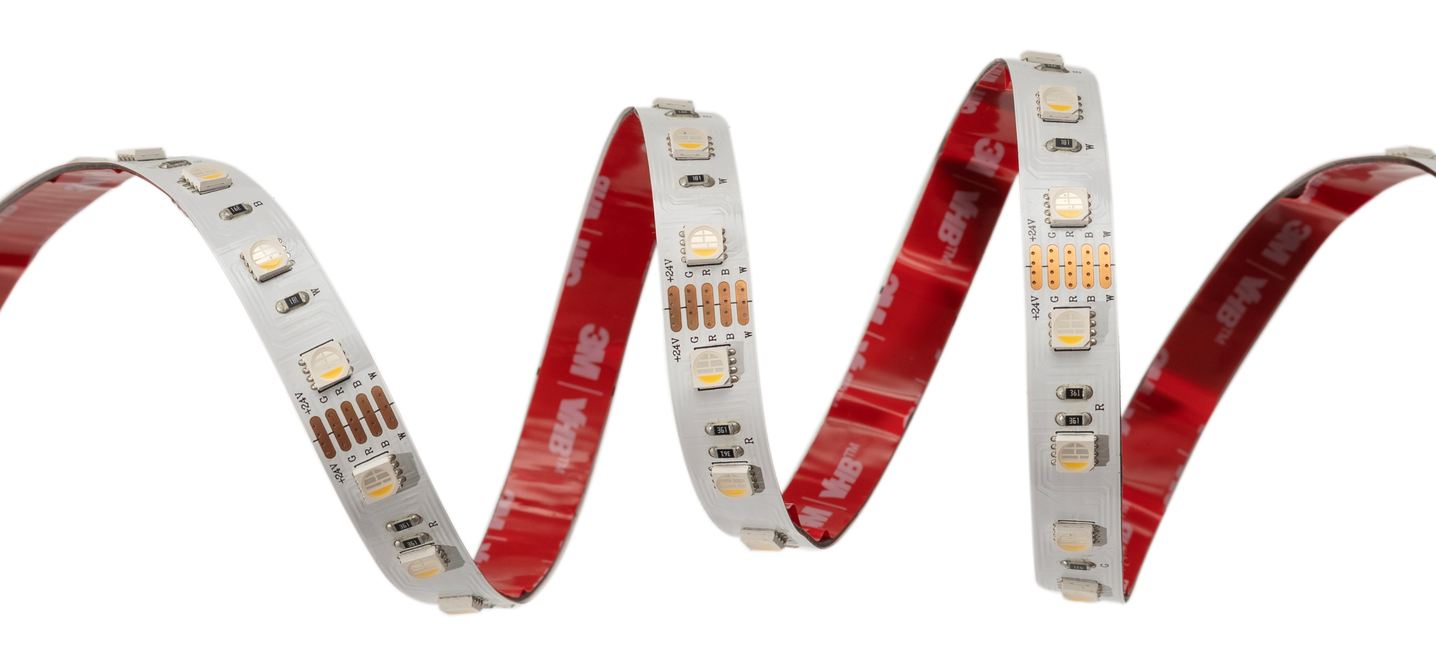
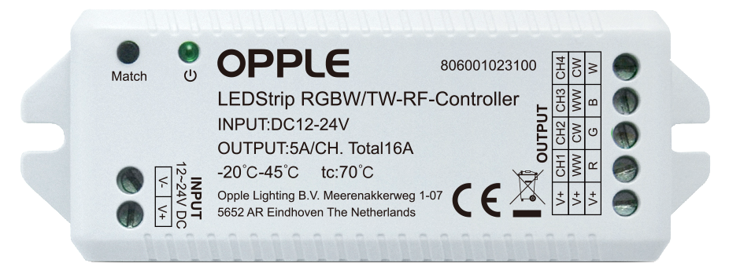



RGBW Strip
Key Technical Specs
Features & Benefits
High-quality IP20 RGBW LED strip with CRI >90
Available in two white color temperatures: 2700K and 4000K
Operates on standard 24VDC with length of 5-meter reels
Compatible with multiple strip connectors for flexible installation
RF controller available as accessory, supports various RGBW and TW remote control
Power | 19.2 W/m
Output | 1200 lm/m
CCT | 2700K, 4000K
Min. Cut Length | 100 mm
Strip Width | 12 mm
Efficacy | 62.5 lm/w
IP | IP20
LED quantity | 60 LEDs per meter
CRI | >90
Lifetime | 70.000h (L70)

