Slide 1


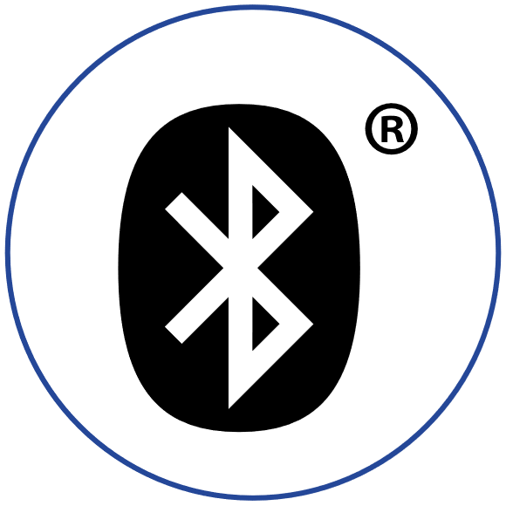

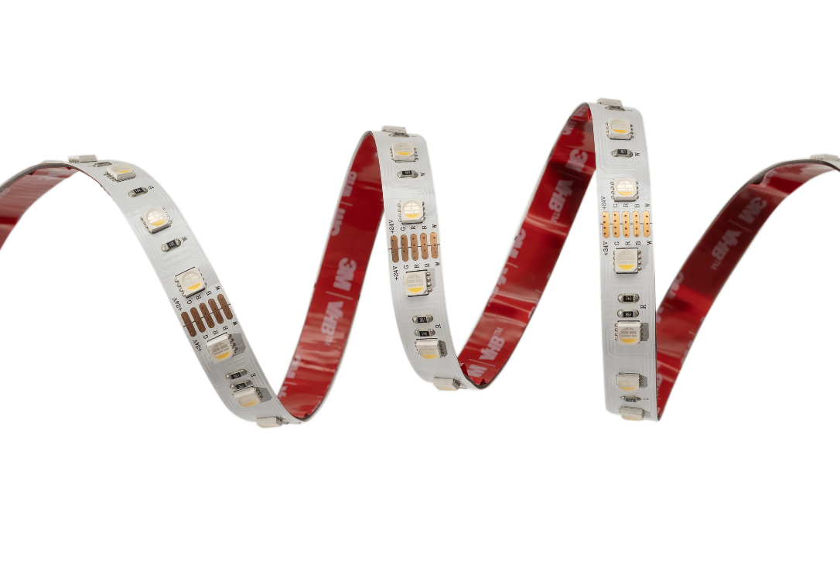
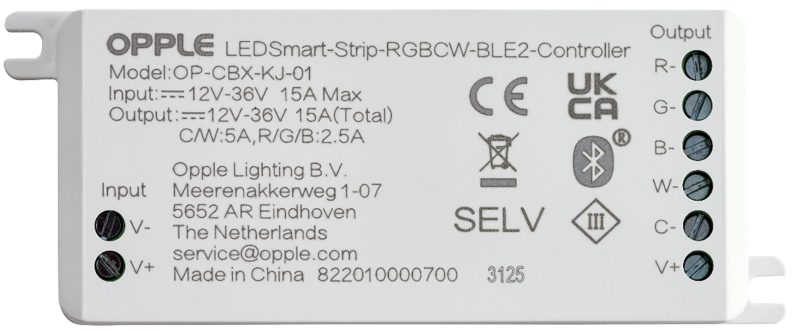

RGBW BLE Controller (Jan 2026)
Features & Benefits
Optional accessory for RGBW Strip
Complete wireless communication via future-proof, standardized Bluetooth® Low Energy (BLE) SIG Mesh protocol
Very easy to set up with the OPPLE Smart Lighting App, or Smart Connect Box through the web user interface
5 channels for RGBW and Tunable White applications
Supply voltage: 12V - 36V
Excellent functions of dimming, color change, making scenes, integrate with other indoor projects.
Enhances productivity by creating an optimal environment

