Slide 1
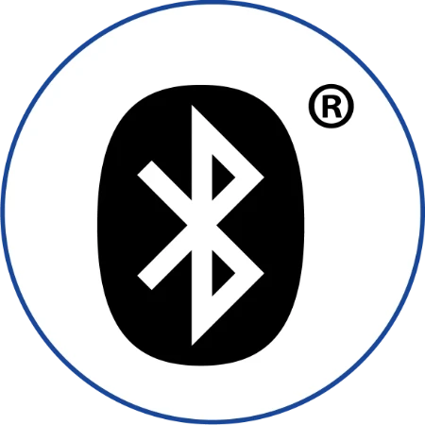






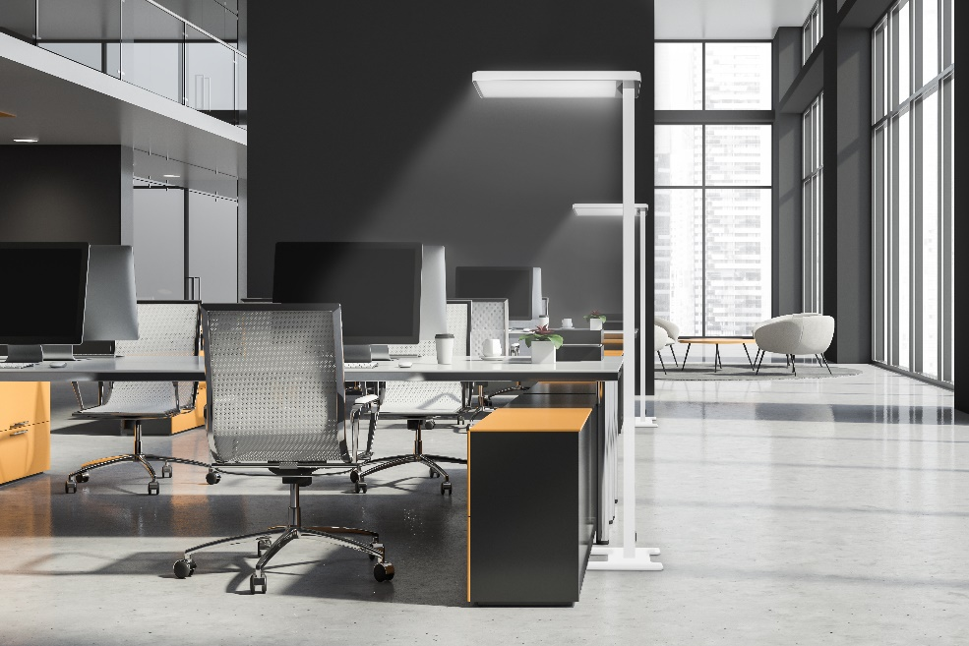
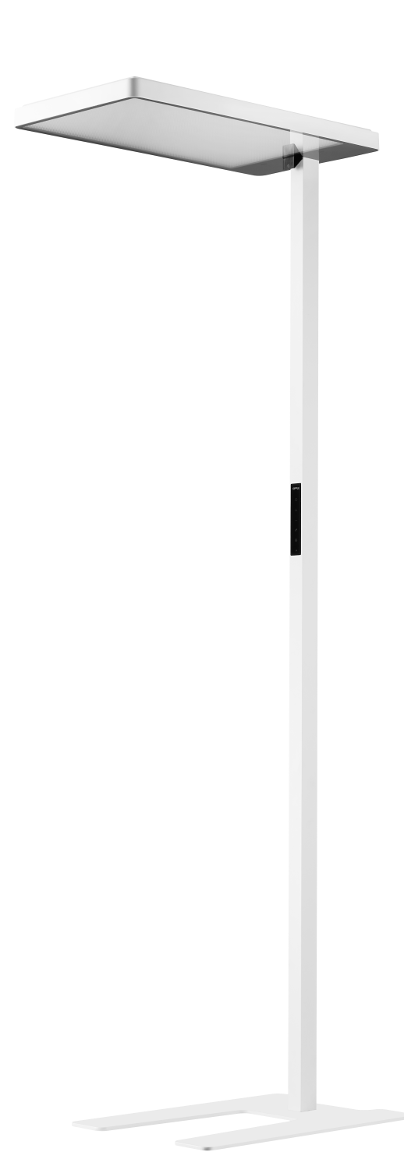
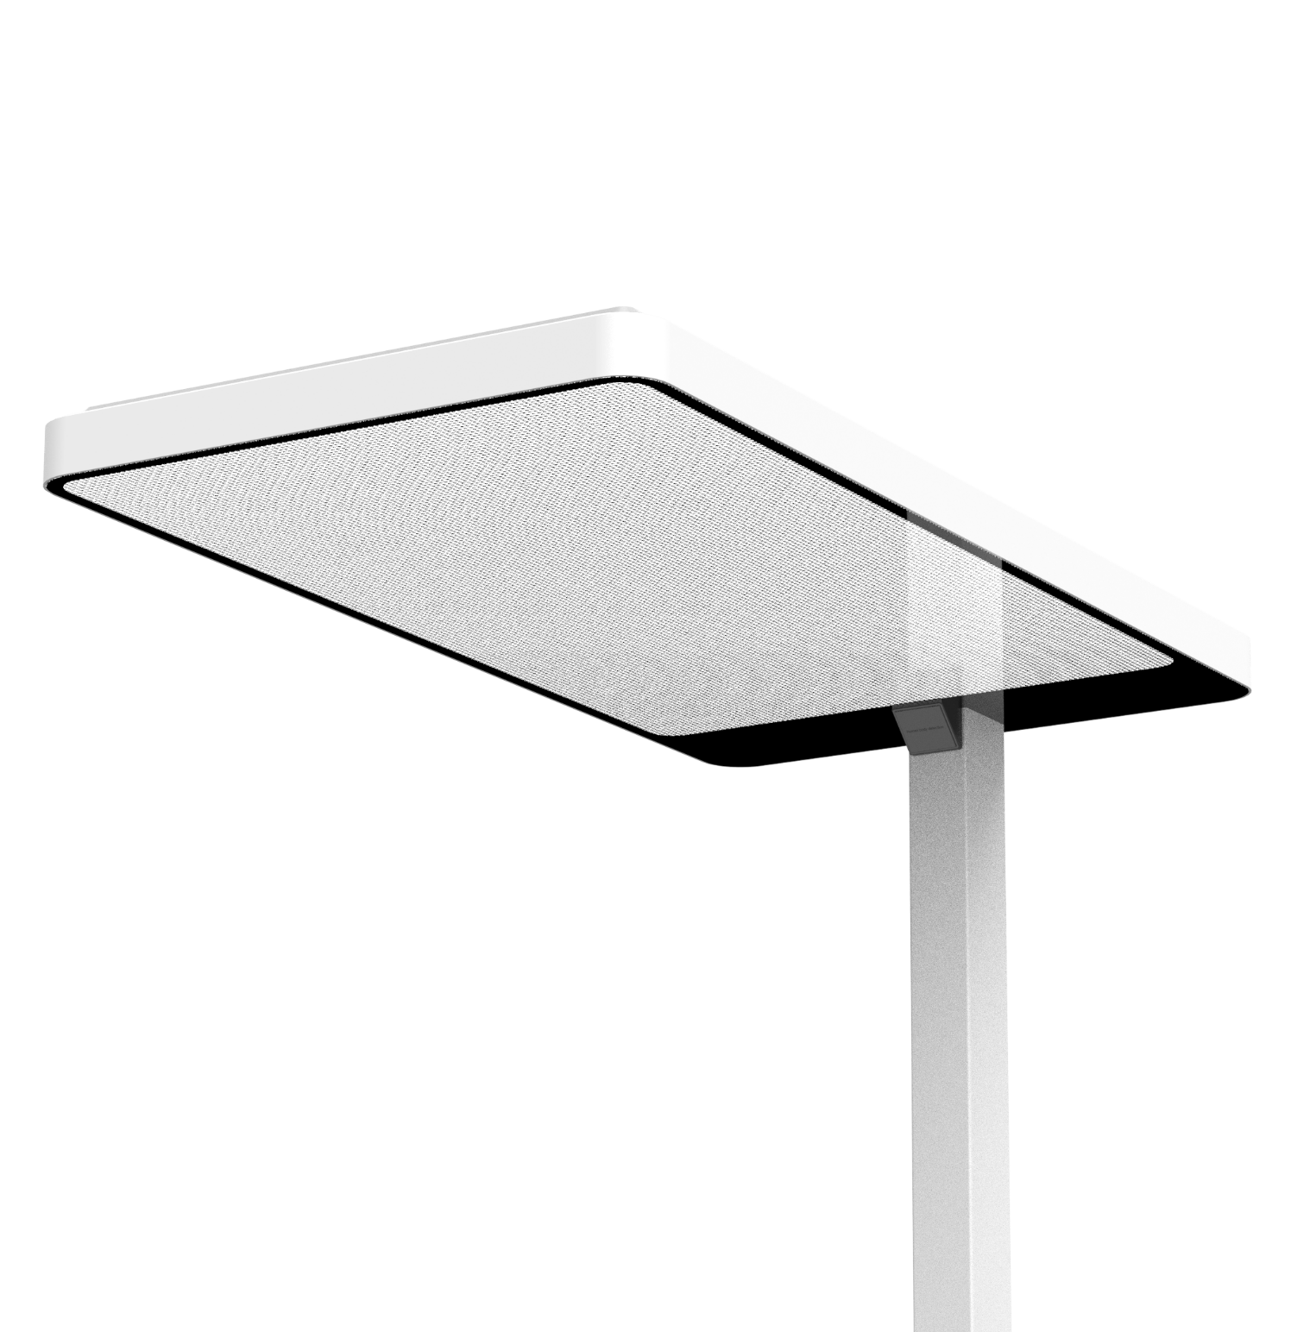
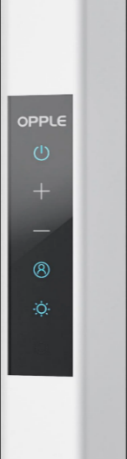

FALCON Tunable white
Features & Benefits
Modern luminaire with direct/indirect light distribution
Extremely comfortable light (UGR < 16)
Stylish touch button control on pole
Integrated motion and daylight sensor
App control via Smart App, possible to connect to Smart Sensors
Key Technical Specs
Power | 100W
CCT | 2700-6500K
Output (lm) | 12.500 lm
Efficacy | 125lm/W
Dimming | BLE2
CRI | >80
IP | IP20
Lifetime | 50,000hrs (L80)
UGR | < 16

