Slide 1
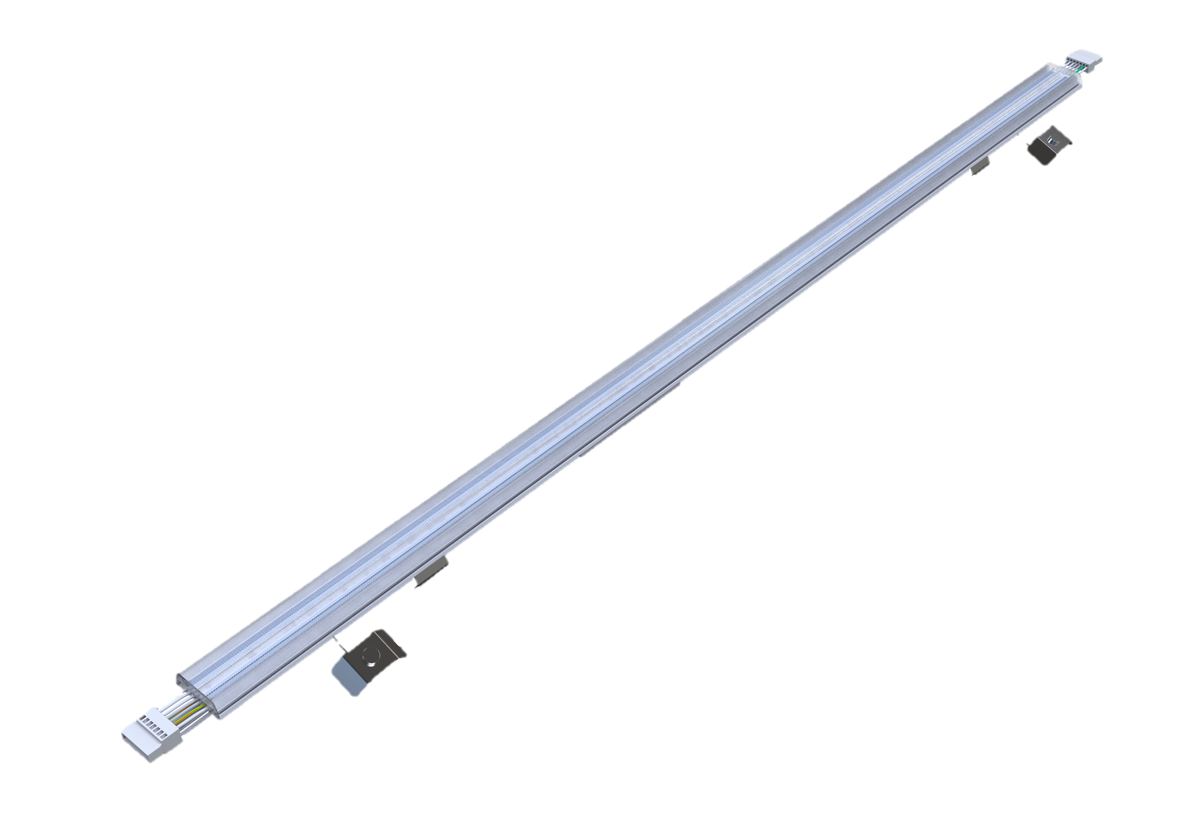
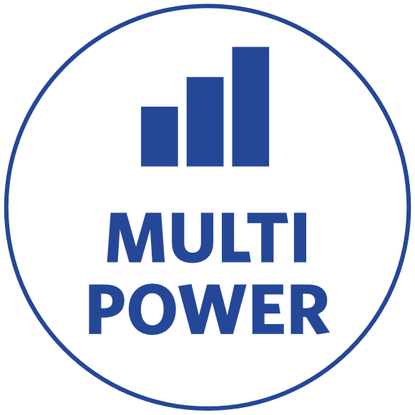


Universal trunking module
Features & Benefits
Universal retrofit module for upgrading existing trunking systems
Tool-free, hassle-free installation for time-saving mounting
Multiple power settings and beam angles for versatile lighting applications
Integrated power switch for quick configuration on-site
Directly compatible with major systems:– Trilux E-Line, Regiolux SMT/SDT/SPT, Siteco DUS, Ridi VLG/VLT/SLG, Philips TTX400, Zumtobel ZX1/ZX2"
With included spring B: also fits Zumtobel Tecton, Siteco Modario, Philips TTX200, and VEKO PNR
Available in DALI dimmable versions for advanced lighting control
Key Technical Specs
Power | 28/46W, 68/85W
CCT | 4000K
Output | 5040/8282lm, 12,240/15,300 lm
Efficacy | 180lm/W
Beam Angle | W(120°), M(80°), N(60°), BW, Diffusor
Dimensions | L1500
Dimming | On/Off, DALI2
CRI | >80
IP | IP20
Lifetime | 100,000hrs (L70)

