Slide 1





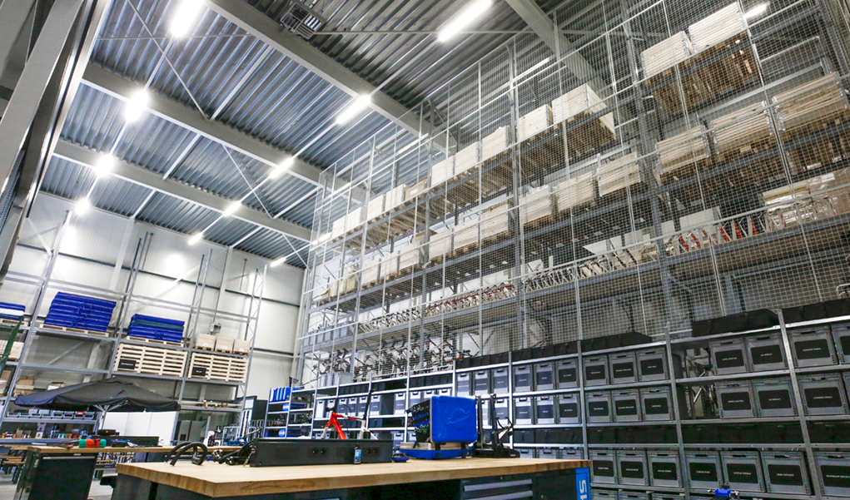
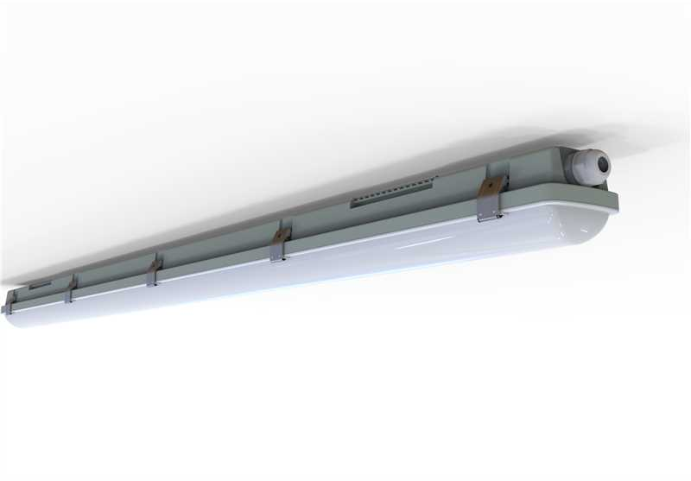

Waterproof ClassIC Ecomax
Features & Benefits
Cost-effective waterproof solution with durable clip design
High system efficacy of 130 lm/W for energy-efficient performance
Integrated power switch and CCT switch as standard for on-site flexibility
Optimized diffuser design ensures uniform and glare-free light distribution
Flexible wiring options: rear or side entry
Available with integrated emergency lighting (EM versions)
Key Technical Specs
Power | 10/18W (0.6m), 18/36W (1.2m), 36/50W (1.5m), 45/60W (1.5m)
CCT | 4000K/5700K (CCT-Switch)
Output | 1,300-7,800lm
Efficacy | 130 lm/W
Dimming | On-Off
IP, IK | IP65, IK08
CRI | >80
Lifetime | 70,000h (L70)

